Slide 1
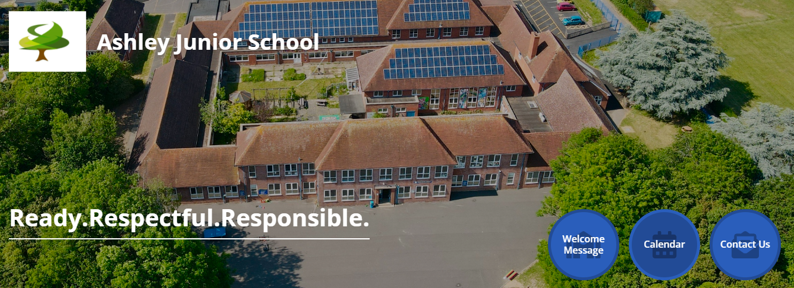

Welcome to the
Year 3 Curriculum Meeting

Slide 2


Welcome…
Curriculum
AJS Behaviour for Learning
House Points, Golden Brush & Role Model of the Week
Key dates
Summary
Any questions?

Slide 3


Slide 4
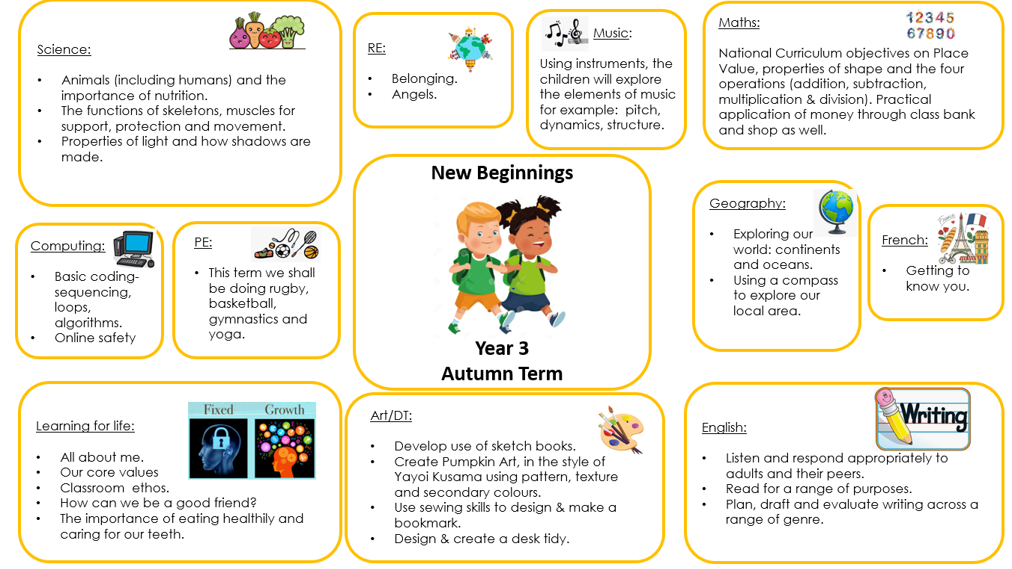

Slide 5
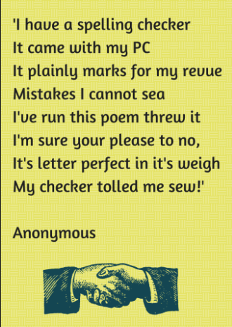
Spellings

Slide 6

Spellings
Increased focus on accuracy of spelling
National Curriculum spellings: High Frequency Words, Year 3 and 4 spelling lists.
Home Learning, online platform called Spelling Frame. Passwords and usernames to follow.

Slide 7
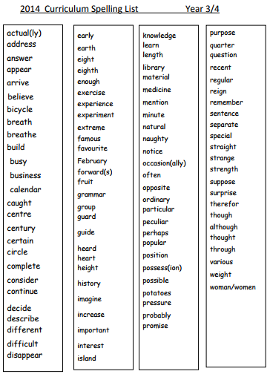

Slide 8
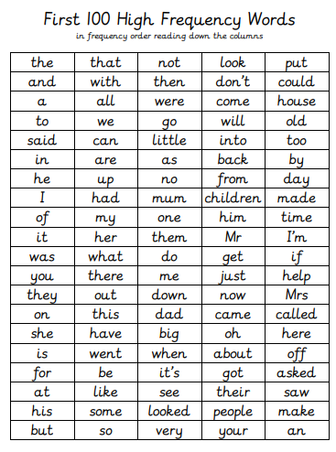

Slide 9

Reading

Slide 10

Reading
Children require reading skills to access the whole curriculum
We encourage children to read a wide range of literature to develop their understanding and vocabulary
Reading River- these will be going
Home Monday 15th September. Every Thursday, they need to be brought back in.

Slide 11
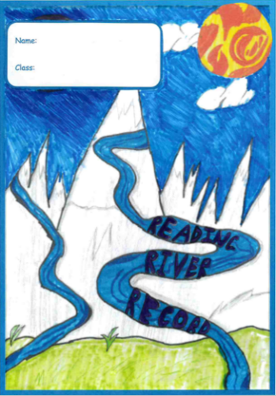
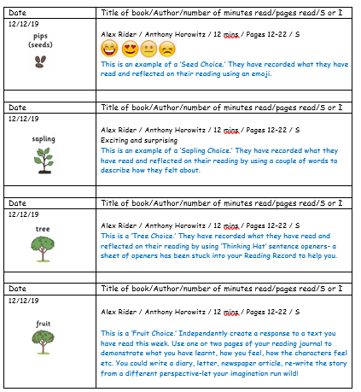
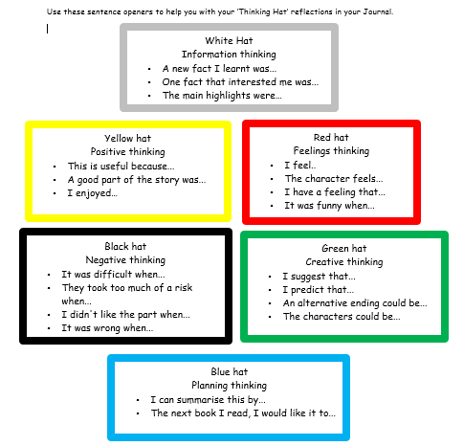

Slide 12
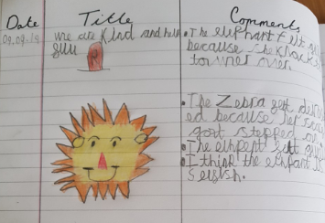
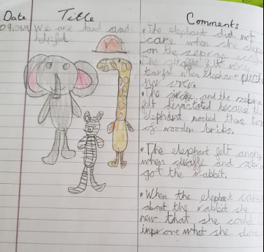
Year 3 Reading Journal example-

Slide 13


Slide 14
Writing
Handwriting needs to be consistent across all books
All of our writing is linked to a text driver
The children are provided with a variety of supportive materials to use independently

Slide 15
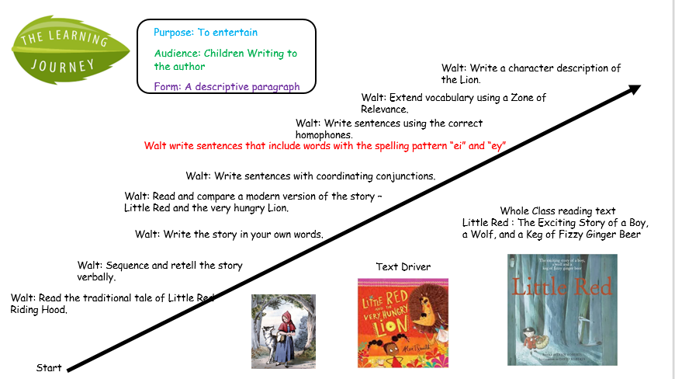

Slide 16

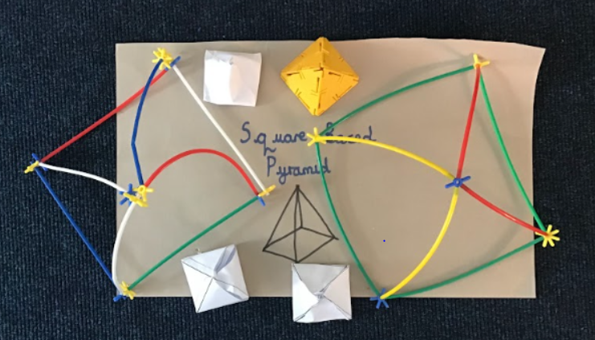
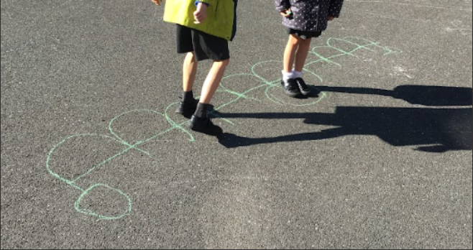
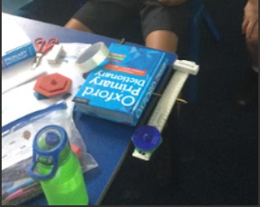
Mathematics
Maths is fun at Ashley Junior School. We use lots of equipment to help the children learn.

Slide 17

Mathematics
We will continue to practise the x2, x5 & x10 tables that the children were introduced to in Year 2.
This year we will be introducing the children to x3, x4 & x8.
Regular practise at home really helps. We use an online platform called TTRockstars. Usernames and passwords to follow soon.

Slide 18
Assessments
JJL-Speech and language assessment
SWSPt
Reading assessments online
Writing –teacher assessments
Maths
Phonics

Slide 19
Behaviour for Learning

Slide 20
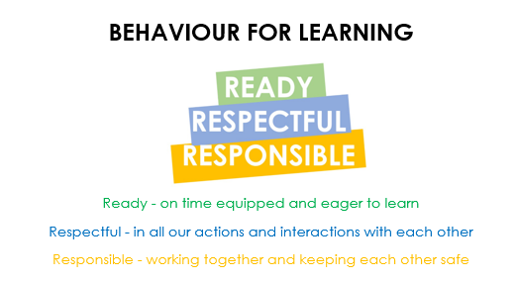

Slide 21
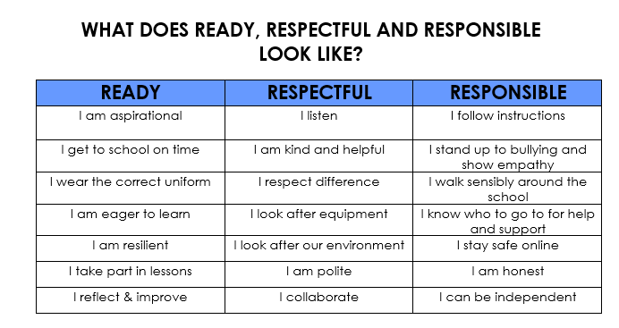

Slide 22



Slide 23
Housepoints, Golden Brush & Role Model of the Week

Slide 24

Key Dates

Slide 25
KEY DATES:
Fun Friday: 19th September 6:00-8:30pm
Parents’ Evening: 23rd September & 24th September
Explorer Dome: date to follow

Slide 26
In summary:
Please encourage your child to…
  Practise their Times Tables
  Practise their spellings on Spelling Frame
  Complete their Reading Rivers
Be engaged, get involved, do their best and have fun!

Slide 27



