Slide 1


Welcome to the
Year 6 Curriculum Meeting
Thursday 11th September 2025

Slide 2
Welcome…
Curriculum
AJS behaviour for learning
House Points, Golden Brush & High Flyers
Key dates
Summary
Any questions?

Slide 3


Slide 4
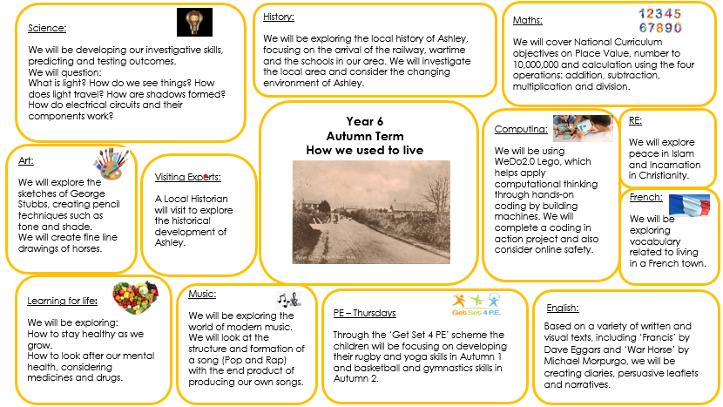

Slide 5
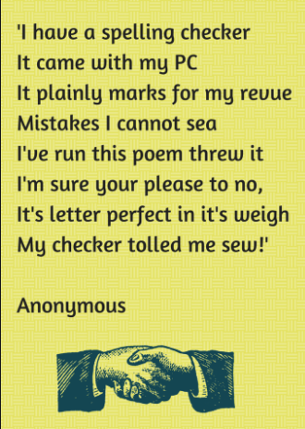
Spellings

Slide 6

Spellings
Expectation of accuracy in spelling
National Curriculum spellings: Year 5 and 6 spelling lists.
Home learning

Slide 7
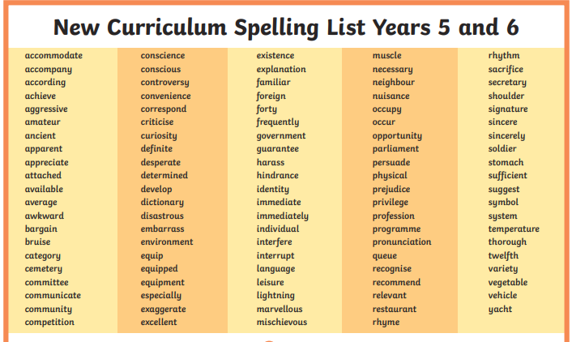

Slide 8
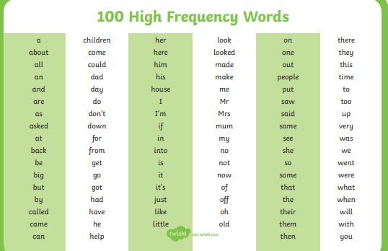
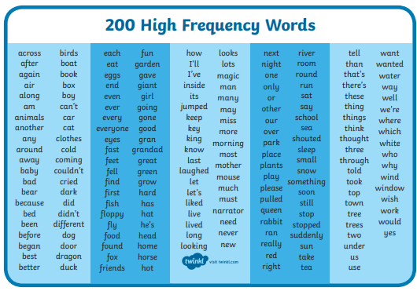

Slide 9
Homework
spelling frame – where we will set their weekly spellings.
Reading plus – they should complete at least one read a week at home.
Reading rivers – three entries per week
In addition
Times table rockstars – to assist those who are not confident with their tables.
Sats revision books
Maths.co.uk

Slide 10

Reading

Slide 11

Reading
Children require reading skills to access the whole curriculum
We encourage children to read a wide range of literature to develop their understanding and vocabulary
Reading River

Slide 12

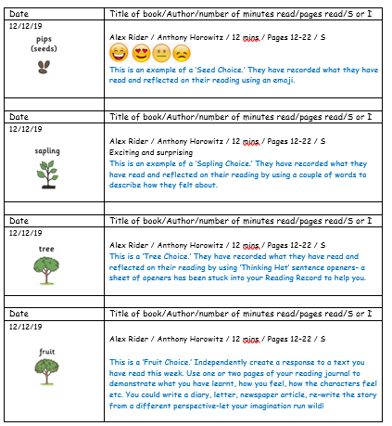
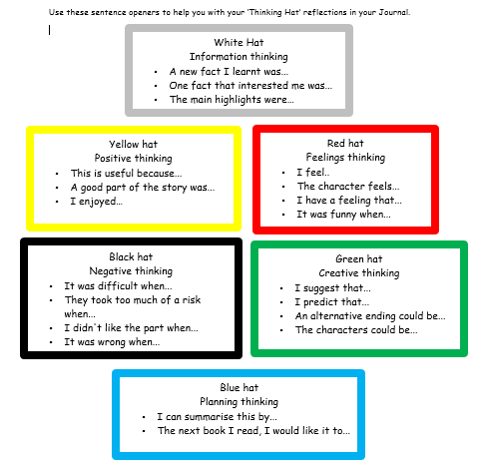

Slide 13


Slide 14
Writing
Handwriting needs to be consistent across all books
All of our writing is linked to a text driver
The children are provided with a variety of supportive materials to use independently

Slide 15
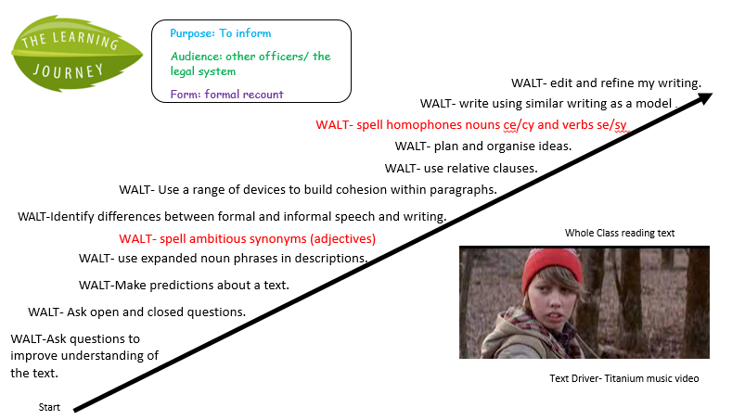

Slide 16
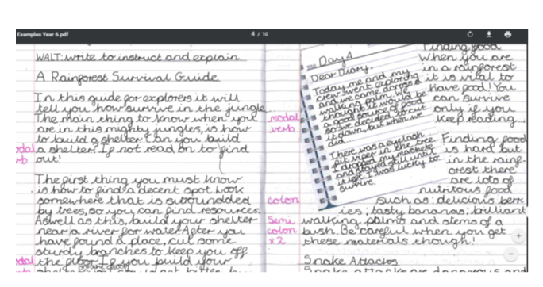

Slide 17
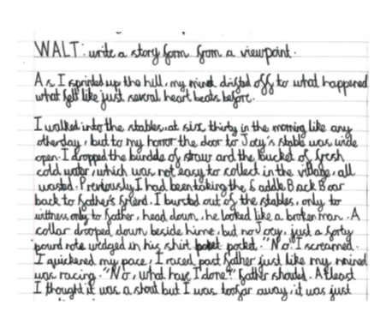

Slide 18


Mathematics
The expectations placed on children have increased greatly in recent years
Required to draw on many different branches of Mathematics and use high-level reasoning skills

Slide 19
Assessments
Reading Plus
NVR- non-verbal reasoning
HFW/ Y5/6 -spelling
Writing –teacher assessments
Maths-
Y6 SATs test (W/C May 11th 2026)in reading GPS and Maths

Slide 20
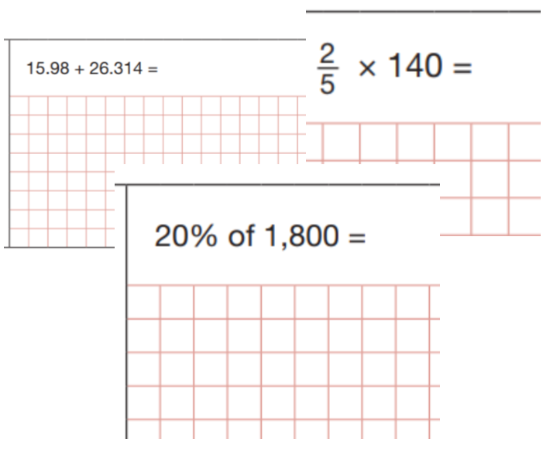
Maths Paper 1
Arithmetic

Slide 21
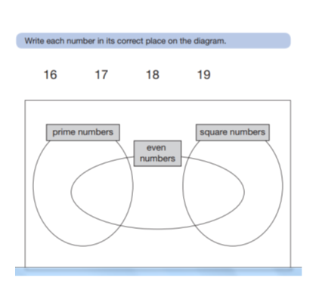
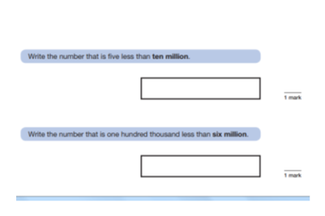
Maths Papers 2 and 3 - reasoning

Slide 22
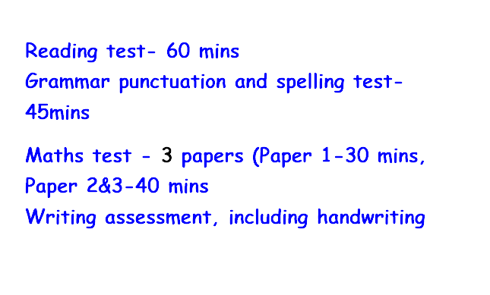
Year 6 Sats – WC 11th May 2026

Slide 23
Timetable

Slide 24
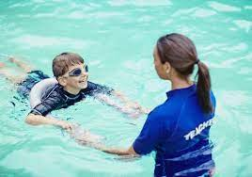

Monday | Library Books
Tuesday
Wednesday
Thursday | PE kits and reading river
Friday
Bikeability is offered to all year 6 children regardless of cycling ability. (14th-16th January)

Slide 25
Behaviour for Learning

Slide 26
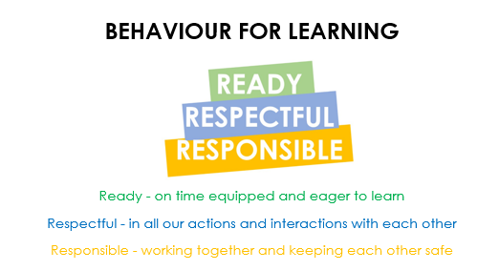

Slide 27

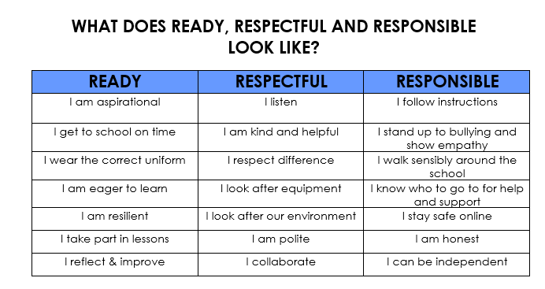

Slide 28



Slide 29
Housepoints, Golden Brush & High Flyers

Slide 30




Slide 31


Slide 32

Key Dates

Slide 33
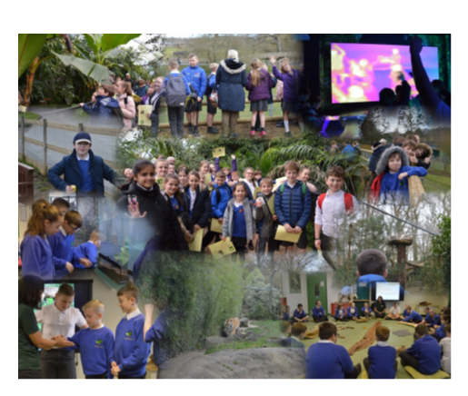
Tuesday 23rd September Parent Consultations 3:40pm - 6:00pm
Wednesday 24th September Parent Consultations 3:40pm - 6:00pm
Monday 27th – Friday 31st October - Half term
School trips:
It is our intention to visit Marwell Zoo in the Spring term to take part in their rainforest workshops!

Slide 34
In summary:
Please encourage your child to…
  Practise their Maths
  Learn their Spellings
  Complete their Reading Rivers
Be engaged, get involved, do their best and have fun!

Slide 35



